Slide 1
BOOK RECOMMENDATION PROJECT
GROUP - 4

Slide 2
Mentor: Ms. Neha Gupta Project Kick Off date: 22 Sep 2022 Team members: Mr. Vipin K C Mr. Vikram Dattatray Yewale Mr. Anirudh C A Miss. Ezhilmathi Arivezhil PAVAN KUMAR M

Slide 3
Table of Contents
Defining Business Problem ,Scope and Objective
Product Description
Flow /Structure of Project Life Cycle
Data collection
EDA / Data Cleaning
Model building
Model deployment

Slide 4
Business Objective:-
Generate, analyze and Process the features from the datasets and use them to recommend books according to the user.

Slide 5
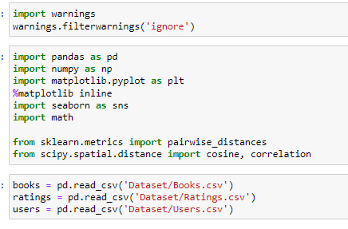
Importing Libraries & Datasets:

Slide 6


Data set Details :-
Users Contains the users. Note that user IDs (User-ID) have been anonymized and map to integers. Demographic data is provided (Location, Age) if available. Otherwise, these fields contain NULL-values.
Books Books are identified by their respective ISBN. Invalid ISBNs have already been removed from the dataset. Moreover, some content-based information is given (Book-Title, Book-Author, Year-Of-Publication, Publisher), obtained from Amazon Web Services. Note that in case of several authors, only the first is provided. URLs linking to cover images are also given, appearing in three different flavours (Image-URL-S, Image-URL-M, Image-URL-L), i.e., small, medium, large. These URLs point to the Amazon web site.
Ratings Contains the book rating information. Ratings (Book-Rating) are either explicit, expressed on a scale from 1-10 (higher values denoting higher appreciation), or implicit, expressed by 0.

Slide 7
Data Cleaning and Pre-Processing
For Books Table:
Drop all three Image URL features.
Check for the number of null values in each column. There comes only 3 null values in the table. Replace these three empty cells with ‘Other’.
Check for the unique years of publications. Two values in the year column are publishers. Also, for three tuples name of the author of the book was merged with the title of the book. Manually set the values for these three above obtained tuples for each of their features using the ISBN of the book.
Convert the type of the years of publications feature to the integer.
By keeping the range of valid years as less than 2022 and not 0, replace all invalid years with the mode of the publications that is 2002.

Slide 8
For Users Table:
Check for null values in the table. The Age column has more than 1 lakh null values.
Check for unique values present in the Age column. There are many invalid ages present like 0 or 244.
By keeping the valid age range of readers as 10 to 80 replace null values and invalid ages in the Age column with the mean of valid ages.
The location column has 3 values city, state, and country. These are split into 3 different columns named; City, State, and Country respectively, keep only Country column. In the case of null value, ‘other’ has been assigned as the entity value.
Removal of duplicate entries from the table.

Slide 9
For Ratings Table:
Check for null values in the table.
Check for Rating column and User-ID column to be an integer.
Removal of duplicate entries from the table.

Slide 10
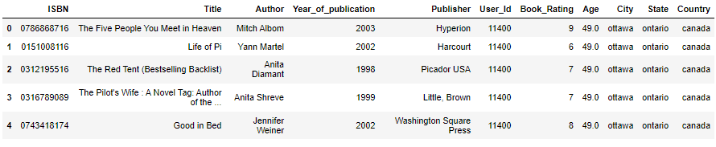
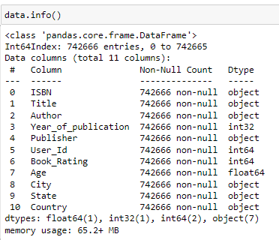
MERGING DATASETS:
Considering ISBN, User-id as the primary Key, merged the datasets.
Divided the datasets with explicit and implicit ratings

Slide 11
Exploratory Data Analysis
Exploratory Data Analysis (EDA) is an approach to analyze the data using visual techniques. It is used to discover trends, patterns, or to check assumptions with the help of statistical summary and graphical representations.
Data visualization
Data Visualization is the process of analyzing data in the form of graphs or maps, making it a lot easier to understand the trends or patterns in the data. There are various types of visualizations .

Slide 12
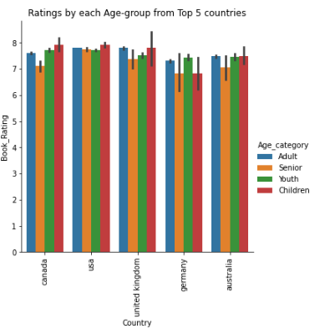
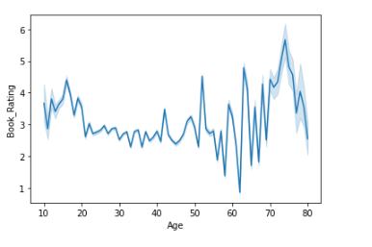
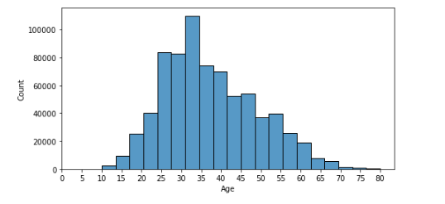
Data Visualization – Based on Age

Slide 13
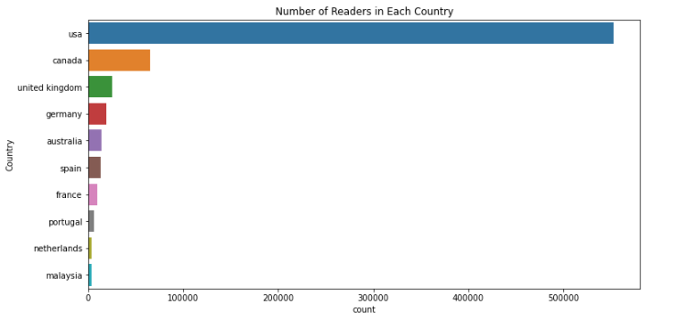
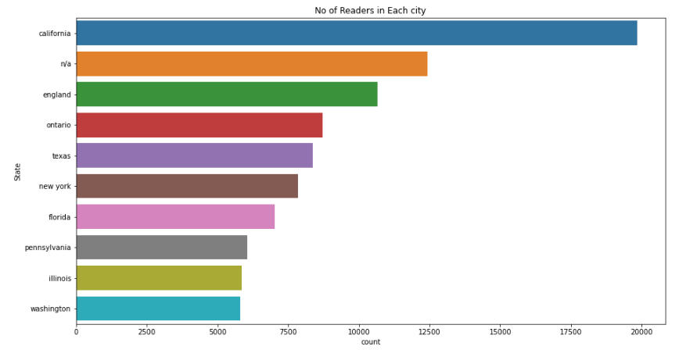
Data Visualization – Based on Demography
The most number of readers are from USA.
California is the city with most number of readers.

Slide 14
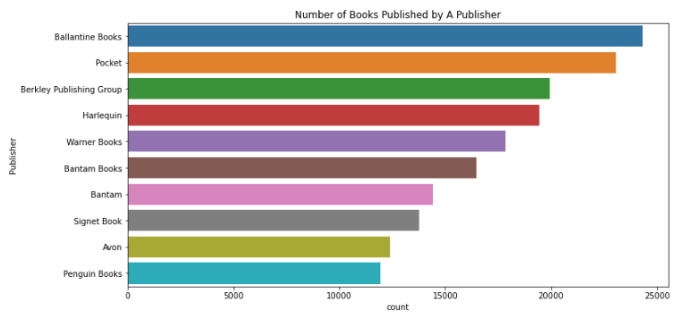
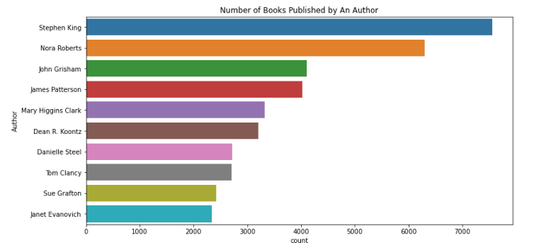
Data Visualization – Based on Publisher and Author
The most number of books are published by Ballantine Books
Stephen King is the author of the books read by most number of users

Slide 15
MODEL BUILDING
A machine learning model is a file that has been trained to recognize certain types of patterns. You train a model over a set of data, providing it an algorithm that it can use to reason over and learn from those data. Once you have trained the model, you can use it to reason over data that it hasn't seen before, and make predictions about those data.
Recommender Systems
It is an algorithm that suggests relevant items to users. Eg: In the case of Netflix which movie to watch, In the case of e-commerce which product to buy, or In the case of kindle which book to read, etc.
There are many use-cases of it. Some are
Personalized Content: Helps to Improve the on-site experience by creating dynamic recommendations for different kinds of audiences like Netflix does.
Better Product search experience: Helps to categories the product based on their features. Eg: Material, Season, etc.

Slide 16
2.Collaborative Based Filtering
Popularity Based Filtering
It is a type of recommendation system which works on the principle of popularity and or anything which is in trend. These systems check about the products which are in trend or are most popular among the users and directly recommend those.
Recommending the new items to users based on the interest and preference of other similar users is basically collaborative-based filtering. This overcomes the disadvantage of content-based filtering as it will use the user Interaction instead of content from the items used by the users. For this, it only needs the historical performance of the users.

Slide 17
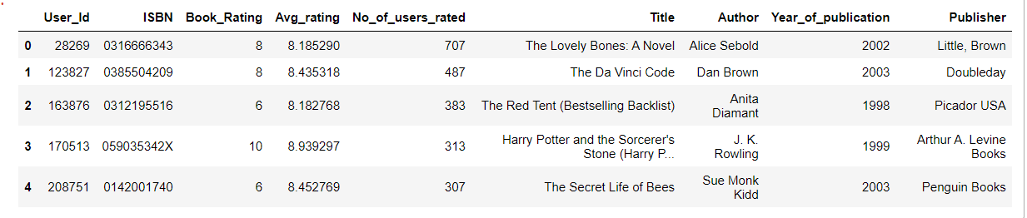
1. POPULARITY BASED
We selected books which received rating atleast 8 and rated by atleast 200 users.
These 5 books received top 5 rating and most number of ratings.So we can recommend these books to any user.

Slide 18
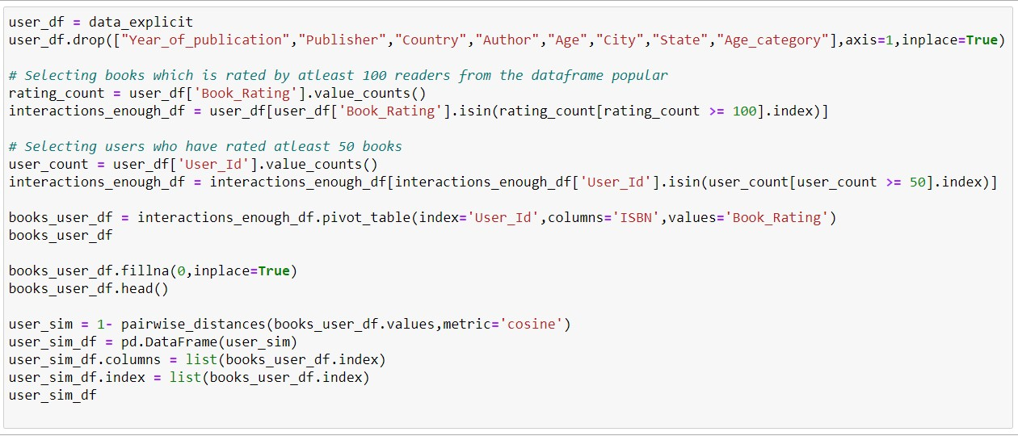
2.User-Based Collaborative Filtering
Rating of the item is done using the rating of neighbouring users.In simple words, It is based on the notion of users similarity.

Slide 19
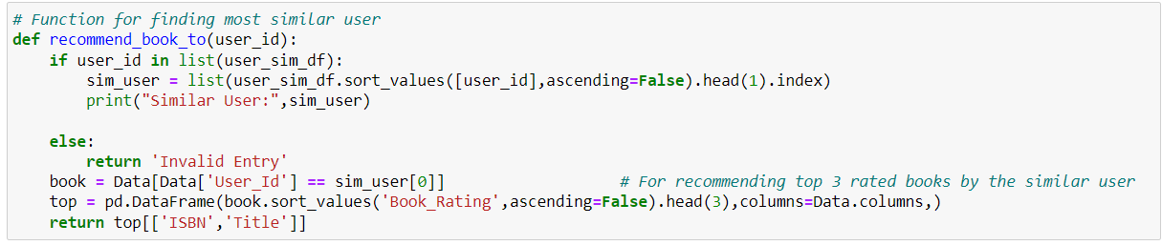
The above function recommends 3 books to the input user.

Slide 20

Model Deployment using streamlit

Slide 21
Thank You

